Slide 1

MarVL
Marketing Analysis and Revenue Value Learning
(Understanding the Metrics Behind Revenue Generation)

Slide 2
INTRODUCTION
Marketing analysis plays a pivotal role in revenue generation by providing valuable insights into market trends, consumer behavior, and competitive landscape. Here are some key points highlighting its importance:
Understanding Customer Needs :Marketing analysis helps businesses understand their target audience's needs, preferences, and pain points. By analyzing customer data, businesses can tailor their products or services to better meet customer demands, leading to increased sales and revenue.
Identifying Market Opportunities : Through market research and analysis, businesses can identify untapped market segments and emerging trends. By capitalizing on these opportunities, businesses can expand their customer base and revenue streams.
Optimizing Marketing Strategies : Marketing analysis allows businesses to evaluate the performance of their marketing campaigns and channels. By identifying which strategies are most effective in reaching and engaging with their target audience, businesses can allocate their marketing budget more efficiently, maximizing ROI and revenue generation.
Competitive Advantage : By conducting competitive analysis, businesses can gain insights into their competitors' strengths, weaknesses, and strategies. This knowledge enables businesses to differentiate themselves in the market, develop unique selling propositions, and stay ahead of the competition, ultimately driving revenue growth.
Risk Mitigation : Marketing analysis helps businesses anticipate market shifts, industry disruptions, and changing consumer preferences. By staying informed and proactive, businesses can mitigate risks and adapt their strategies to maintain steady revenue streams even in volatile market conditions.

Slide 3


What is Marketing Analysis?
Marketing analysis is the process of evaluating various aspects of a market to understand its dynamics, trends, and opportunities. It involves gathering, interpreting, and synthesizing data related to customers, competitors, and the overall business environment to inform strategic decision-making and improve marketing effectiveness.

Slide 4
Types of Marketing Analysis

Slide 5



Market segmentation involves dividing a broad market into smaller, more manageable segments based on shared characteristics such as demographics, psychographics, behaviors, or needs.
Market Segmentation Analysis
Competitive analysis involves assessing the strengths, weaknesses, strategies, and market positioning of competitors.
Competitive Analysis
SWOT (Strengths, Weaknesses, Opportunities, Threats) analysis is a strategic planning tool used to evaluate the internal strengths and weaknesses of a business, as well as external opportunities and threats in the market
SWOT Analysis

Slide 6
Key Metrics in Marketing Analysis
Customer Acquisition Cost (CAC)
Conversion Rate
Customer Lifetime Value (CLV)
Churn Rate
Return on Investment (ROI)
Customer Satisfaction (CSAT)

Slide 7

Challenges and Considerations
"Effective marketing analysis is essential for businesses to make informed decisions and drive growth. However, it comes with its own set of challenges and considerations:
Data Quality and Accessibility: Ensuring the quality and accessibility of data is crucial for accurate analysis and insights.
Interpreting Complex Data: Analyzing multifaceted marketing data requires advanced skills and tools to derive actionable insights.
Privacy and Compliance: Businesses must navigate data privacy regulations and maintain transparency to build trust with customers.
Attribution and Measurement: Accurately attributing value to marketing channels and measuring their impact on conversions is challenging, especially in multi-channel campaigns.
Real-Time Analysis and Adaptation: The dynamic nature of the marketing landscape requires businesses to analyze data in real-time and adapt strategies quickly.
Resource Constraints: Budget, expertise, and infrastructure constraints may limit the adoption of marketing analytics, especially for smaller businesses.

Slide 8
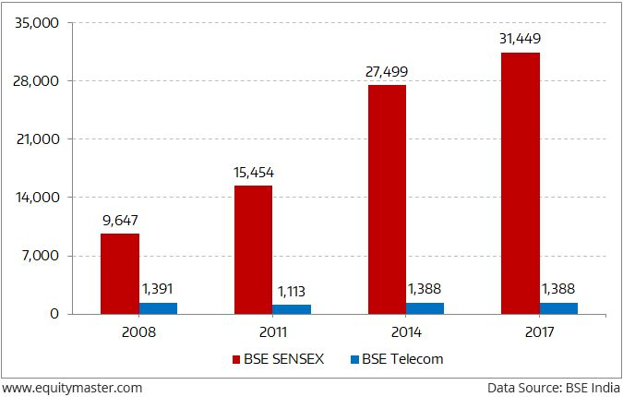
EQUITY MARKET AND SUCCESS
TODAY IN INDIA

Slide 9

CONCLUSION
In conclusion, continuous analysis and learning are fundamental for driving revenue growth in today's dynamic business environment. By staying agile and adaptable, businesses can effectively respond to market changes, optimize their marketing efforts, enhance the customer experience, identify revenue opportunities, and maintain a competitive advantage. Embracing a culture of continuous improvement and investing in analytics capabilities enables businesses to achieve sustainable revenue growth and long-term success.

Slide 10
THANK YOU

